Slide 1
UE19CS345 – Network Analysis and Mining
Course Project
Project Title :
NASHVILLE MEETUP ANALYSIS
Team members:
Priya Mohata PES2UG19CS301 E
R Sharmila PES2UG19CS309 E
Rishab PES2UG19CS327 E
Ritik PES2UG19CS332 E
Colab notebook link:
https://colab.research.google.com/drive/1AanBWZPHQ0uRlXq8ubay4PVj-iv1JmKY?usp=sharing

Slide 2

Topic and its uniqueness
Meetup is a social media platform for finding and building communities and organizing get-togethers with those who share similar interests.
Founded in 2002, it has become quite popular in US with 44 million active users worldwide.
It was acquired by WeWork in 2017 and recently sold in 2020 to AlleyCorp, a venture fund and incubator company. About 62% of the users are from US, 18% from UK, Canada, Germany, Australia, and 20% from other countries.

Slide 3
Topic and its uniqueness
Social Network Analysis (SNA), is a branch of Network Analytics, that investigates social structures. It can be used to analyze what roles individuals play in a social group or structure.
Examples of social networks include social media groups (Facebook, Pinterest, Snapchat, etc.), Special Interest Groups, Club Network, Business Networks, etc. Visualization of social networks is known as a sociogram. Graph theory is used to study networks. There are multiple use cases for visualizing social networks. For businesses, analysis could help in understanding how products could be launched and how their adoption could be influenced. We already are aware of the role influencers play in marketing a product. For government bodies, this analysis could help in dissemination of information, adoption of model social behaviors.

Slide 4
Key Metrics
Components: Number of unconnected/isolated subgroups within a network.
Centrality: Number of relationships of an individual (aka node)
Closeness: Distance of path between two nodes
Degree Centrality of Proximity:
Total number of links a node has to other nodes, combined for the entire group. This helps indicate the individuals who have significant power in aiding transfer of information. Individuals with higher degrees have the ability to connect easily with a large group.
Betweenness Centrality:
Individuals/Nodes that are most important in a network based on centrality of a given node in a network. These individuals influence the transfer of information to subgroups.

Slide 5
Key Metrics
Eigenvector Centrality:
Relative importance of a node with other important nodes in the network. These individuals are central to a network, have the greatest number of relations and influence in a network.
Clustering Coefficient: Degree of nodes clustering or forming groups.
Network Diameter:
Largest value of all the shortest paths between any pairs of nodes, that provides an idea of how long it would take for a message, idea or information to pass through the network.

Slide 6
Problem statement
Social Network of Meetup Group Analysis using graph theory and visualization of a network Nashville is the most populous city of Tennessee. It is ranked as the 7th friendliest city in US. Major part of the demographic is of residents between the age group of 24–35, indicating that it would be attractive for young professionals to stay in this city. Nashville is called the Music City and has some of the best music museums. The city also offers great food and ample hiking spots more than just Smoky Mountains. This Project explores the social media platform Meetup for Nashville city.

Slide 7
Initial approach
The downloaded dataset is uploaded onto the ipynb notebook. Through this project, we aim to build and visualize the Meetup dataset and also gain a better understanding about the structure and relations between different members in this dataset by analyzing the network using the Python networkX package.
Basic preprocessing is done using pandas package including removal of unnecessary data and normalizing it.
Visualizations are made using pyplot package.
Finally, cycle detection is done to detect cycles in the graph.

Slide 8
Dataset
meetup.com is a website for people organizing and attending regular or semi-regular events ("meet-ups"). The relationships amongst users—who goes to what meetups—are a social network, ideal for graph-based analysis.
This dataset was generated for a talk titled Principles of Network Analysis with NetworkX, embedded online here (or with notebooks, etc. on Github). It forms the basis for a series of tutorials I presented on at PyNash and PyTennessee. In them, we work through the basics of graph theory and how to use NetworkX, a popular open-source Python package. We then apply this knowledge to extract insights about the social fabric of Tennessee MeetUp groups.
The dataset has 1.17M members, spread over 456 meetup groups.

Slide 9
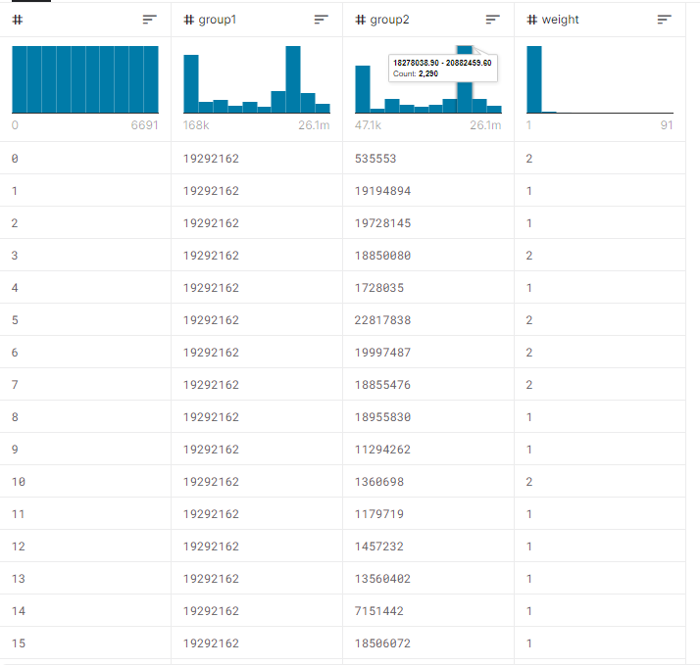

Slide 10
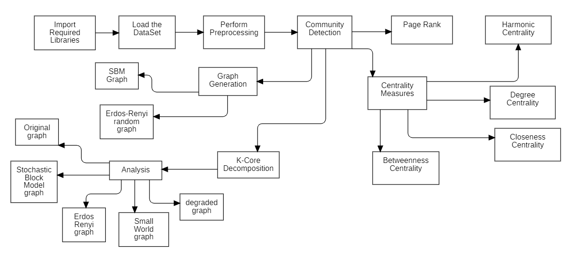
Overall design or approach in a free hand diagram

Slide 12
Final results
Slide number | Content
11 | Character Graph
12 | Degree Distribution of Dataset
13 | Community Detection
14 | Finding Degree centrality, Betweenness Centrality, and closeness centrality
15 | ROC AUC Curve
16 | Binary Accuracy and loss vs epoch graph

Slide 13
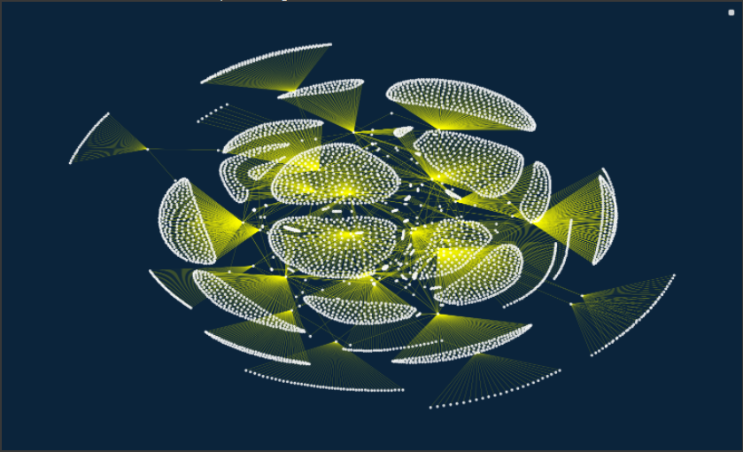
Network Graph

Slide 14
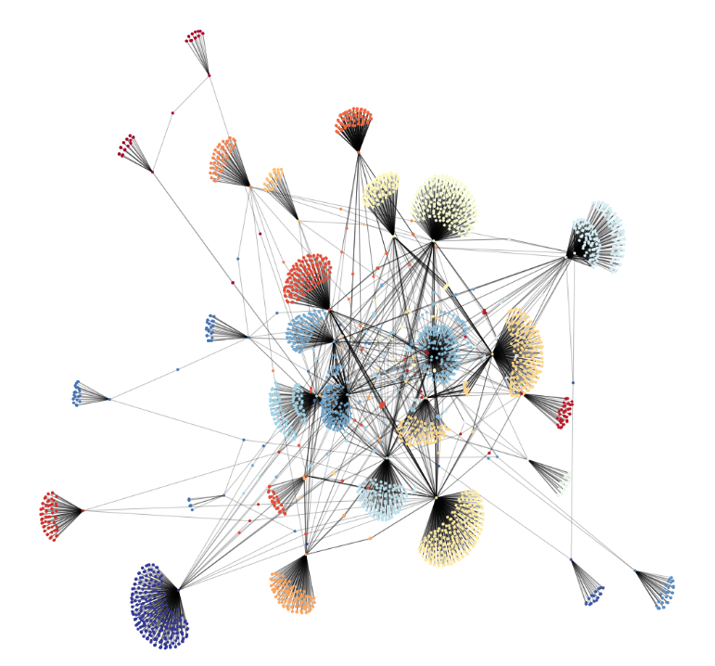
Community in the Dataset

Slide 15
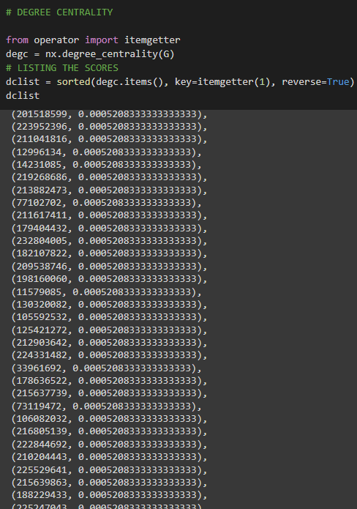
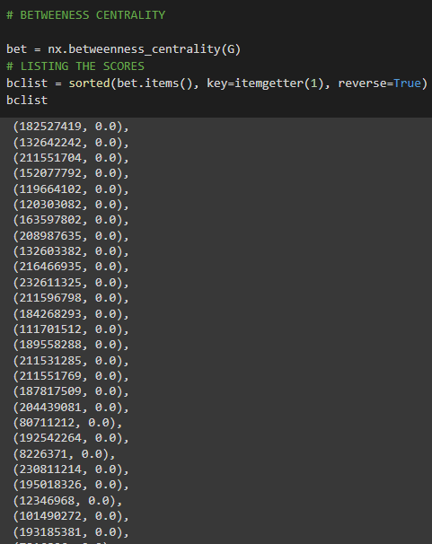
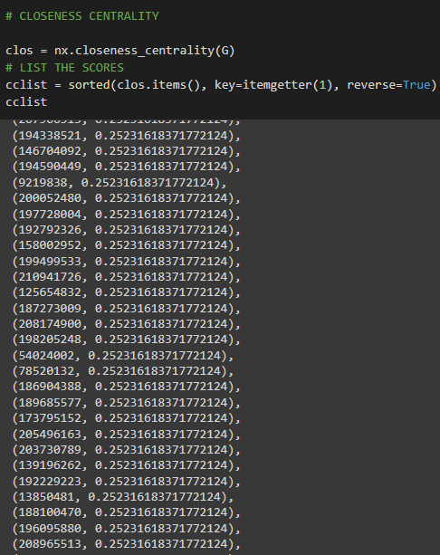

Slide 16
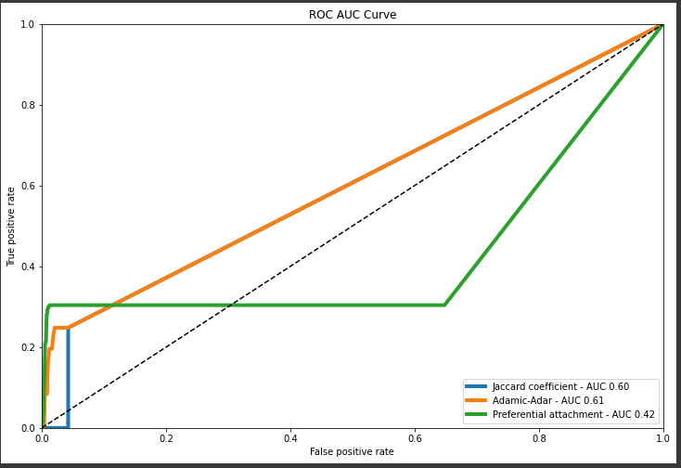

Slide 17
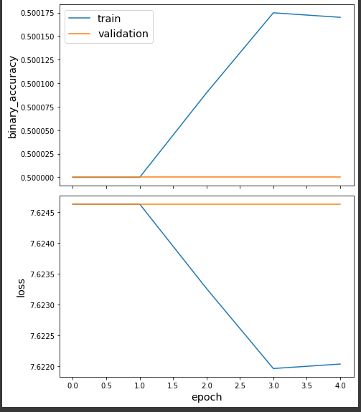

Slide 18
Quantity and quality of work
no | Code functionality | % Complete | Runs without problem (Y/N) | If there are minor issues, indicate
1 | Comparison Between Traditional And Graph ML | 100% | yes | -
2 | To find correlation between various network analysis metrics | 100% | yes | -
3 | Cycle detection for directed graph | 100% | yes | -
4 | To find the egocentricity among nodes | 100% | yes | -

Slide 19
Top few learning
Serial No | Top learning in this project
1 | Who are the top influencers in the group
2 | Who are the people who are best at transferring information in the group
3 | traditional methods are better than GraphML, by a majority, and PA model is almost similar to Graph Sage.

Slide 20
Top unresolved challenges
Serial No | Brief description of unresolved challenges | Type of challenge (scope/data/design/implementation / others)
1 | Graph after Spectral Clustering couldn’t be implemented as its labels could be removed making the graph have unwanted patterns. | Implementation

Slide 21
Reference papers, if any
No | Paper Title | Authors
1 | Social network visualization and analysis | PIERRE KIEFFER

Slide 22
Reference papers, if any
No | Paper Title | Authors
1 | Social network visualization and analysis | PIERRE KIEFFER

Slide 23
Thank You

